Slide 1
Aggregation
Module 5

Slide 2
Module Objectives
Upon completion of this module, you will be able to:
List and define the advantages and nuances associated with event aggregation.
Choose an optimized event aggregation setting that meets your environment requirements.
Customize event aggregation fields on a per signature basis.
List and define the advantage and nuances associated with flow aggregation.
Customize flow aggregation port settings to me your network flow monitoring needs.

Slide 3

Module Topics
Event Aggregation
McAfee Event Aggregation Levels
Custom field Event Aggregation
Flow Aggregation
Flow Aggregation Levels
Flow Port Aggregation

Slide 4
What is Event Aggregation?
Instead of forcing you to sift through thousands of identical events, the event aggregation feature allows you to conveniently view them as a single event with an “event count” that indicates the number of times the event occurred.
Aggregated events by default are events that have fields (e.g., source IP, destination IP, and signature ID) that match
Aggregated events use First time, Last time, and total fields to indicate event properties and details
Some events could potentially be generated thousands of times.
No need to sort through thousands of events, simply observe a single event with an event count the represents the total
Using event aggregation also more efficiently utilizes disk space on both the device and ESM and it eliminates the need to store each packet that generated one of the events
This feature only applies to those rules that have aggregation enabled in the Policy Editor
Notes:
Important Note:
For iPv6 events, the Source IP is the low 4 bytes of the iPv6 Source IP

Slide 5
Aggregation and Timestamps
Aggregated events use the first time, last time, and total fields to indicate the duration and amount of aggregation occurring If the same event occurred 30 times in the first ten minutes after noon, the event’s first time field will contain the time 12:00 (the time of the first instance of the event), the last time field will contain the time 12:10 (the time of the last instance of the event), and the total field would contain the value 30.

Slide 6
Simplified Aggregation Example
Raw Events
SigID | SRC IP | DST IP | Event | First Time | Last Time | Count
0001 | 1.1.1.1 | 2.2.2.2 | ACL Block | 01:00:01 | 01:00:01 | 1
0001 | 1.1.1.1 | 2.2.2.2 | ACL Block | 01:01:00 | 01:01:00 | 1
0001 | 1.1.1.1 | 2.2.2.2 | ACL Block | 01:01:40 | 01:01:40 | 1
0001 | 1.1.1.1 | 2.2.2.2 | ACL Block | 01:02:10 | 01:02:10 | 1
0001 | 1.1.1.1 | 2.2.2.2 | ACL Block | 01:02:55 | 01:02:55 | 1
0001 | 1.1.1.1 | 2.2.2.2 | ACL Block | 01:03:15 | 01:03:15 | 1
0001 | 1.1.1.1 | 2.2.2.2 | ACL Block | 01:04:20 | 01:04:20 | 1
Aggregated Events
SigID | SRC IP | DST IP | Event | First Time | Last Time | Count
0001 | 1.1.1.1 | 2.2.2.2 | ACL Block | 01:00:01 | 01:04:20 | 7
Notes:
Aggregated events use First time, Last time, and total fields to indicate the event properties and details. There is no need to sort through thousands of events, as we can simply observe a single event with an event count to gain a holistic view of the actions occurring.

Slide 7
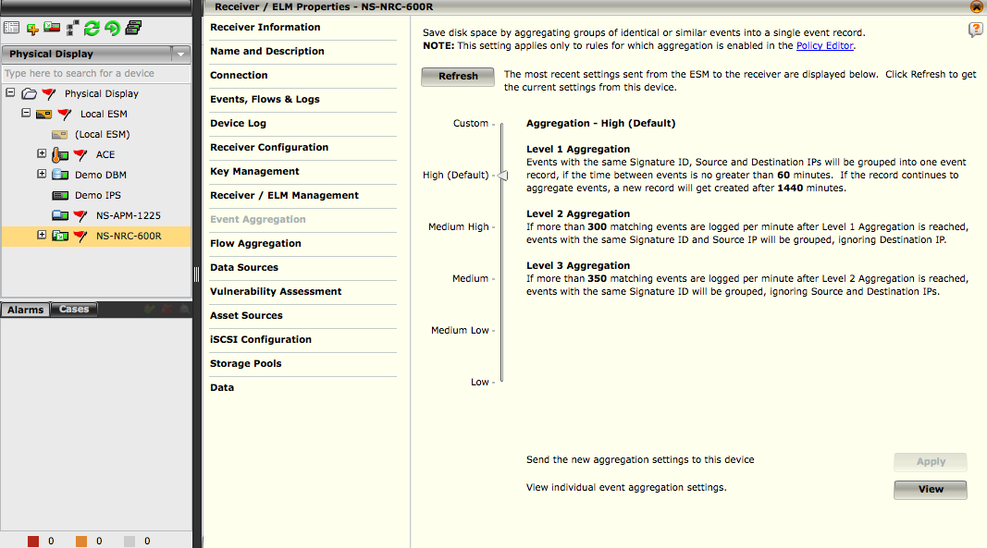
Event Aggregation
2
There are six (6) possible settings:
Custom
High (default)
Medium High
Medium
Medium Low
Low
Each setting has three (3) levels of aggregation
To change the current setting, click on the indicator arrow and drag it to the desired setting
3
1
Notes:
To access the Event Aggregation screen:
Click on a Receiver in the System Navigation Tree.
Click on the Properties icon in the Actions Toolbar. The Receiver Properties screen will open.
Click on Event Aggregation. The Event Aggregation screen will open.

Slide 8
Default Aggregation Settings
Aggregation settings by Default are set to HIGH
This allows for higher ESM data rates from the receivers and also allows the receivers to process more data
Changing the aggregation settings has an effect on the following areas:
ESM event ratings (EPS)
ESM EPS ratings are based on the default aggregation settings. Changing these values will reduce these numbers
ESM storage
Changing these rates will result in the ESM needing to store more events, consuming more disk space
Views
Operators will have to view more events while resolving and reviewing issues
Remember that all raw logs are sent to the ELM and the ESM is not designed for full log storage

Slide 9
Event Aggregation – High (Default)
Level 1 Aggregation: Events with the same Signature ID, Source and Destination IPs will be grouped into one event record, if the time between events is no greater than 60 minutes (1 Hour). If the record continues to aggregate events, a new record will get created after 1440 minutes (24 Hours or 1 Day)
Level 2 Aggregation: If more than 300 matching events are logged per minute after Level 1 Aggregation is reached, events with the same Signature ID and Source IP will be grouped, ignoring Destination IP.
Level 3 Aggregation: If more than 350 matching events are logged per minute after Level 2 Aggregation is reached, events with the same Signature ID will be grouped, ignoring Source and Destination IPs.
Notes:
How event aggregation levels move from one level to the next higher level using default “HIGH” settings:
Start at Level 1 Aggregation
Receive event with SIP 1, DIP 2, SIG 1 and see if event already exists.
If event does not exist create new event record.
If event does exist increment the event count and update the last time field in previous event record.
Events continue to be received repeating step 1 until 300 event records have been created within one (1) minute.
If 300 or less events have been received in one (1) minute stay at level 1 aggregation
If 301 or more events have been received transition to level 2 aggregation
Level 2 Aggregation
Receive events with SIP 1, DIP 2, SIG 1 and see if event already exists.
If event does not exist set the Destination IP (DIP) to 0.0.0.0 and check if event record for this aggregated event exists
If aggregated event (DIP 0.0.0.0) exists update event record count
If aggregated event (DIP 0.0.0.0) does not exist create a new aggregated event record with DIP 0.0.0.0
If event does exist increment the event count and update the last time field in previous aggregated event record.
Events continue to be received repeating step 1 until 350 event records have created within one (1) minute
If 350 or less events have been received in one (1) minute stay at level 2 aggregation
If 351 or more events have been received transition to level 3 aggregation
Continued on next page

Slide 10
Hidden
Notes:
Level 3 Aggregation
Receive events with SIP 1, DIP 2, SIG 1 and see if event already exists.
If event does not exist set the Source IP (SIP) to 0.0.0.0 and check if event record for this aggregated event exists
If aggregated event (SIP 0.0.0.0) exists update event record count
If aggregated event (SIP 0.0.0.0) does not exist create a new aggregated event record with SIP 0.0.0.0
If event does exist increment the event count and update the last time field in previous aggregated event record.
Events continue to be received repeating step 1 until a 60 minute or 1 Hour time window expires.

Slide 11
Event Aggregation – Medium High
Level 1 Aggregation: Events with the same Signature ID, Source and Destination IPs will be grouped into one event record, if the time between events is no greater than 45 minutes. If the record continues to aggregate events, a new record will get created after 820 minutes.
Level 2 Aggregation: If more than 1000 matching events are logged per minute after Level 1 Aggregation is reached, events with the same Signature ID and Source IP will be grouped, ignoring Destination IP.
Level 3 Aggregation: If more than 1500 matching events are logged per minute after Level 2 Aggregation is reached, events with the same Signature ID will be grouped, ignoring Source and Destination IPs.
Notes:
How event aggregation levels move from one level to the next higher level using “Medium High” settings:
Start at Level 1 Aggregation
Receive event with SIP 1, DIP 2, SIG 1 and see if event already exists.
If event does not exist create new event record.
If event does exist increment the event count and update the last time field in previous event record.
Events continue to be received repeating step 1 until 1000 event records have been created within one (1) minute.
If 1000 or less events have been received in one (1) minute stay at level 1 aggregation
If 1001 or more events have been received transition to level 2 aggregation
Level 2 Aggregation
Receive events with SIP 1, DIP 2, SIG 1 and see if event already exists.
If event does not exist set the Destination IP (DIP) to 0.0.0.0 and check if event record for this aggregated event exists
If aggregated event (DIP 0.0.0.0) exists update event record count
If aggregated event (DIP 0.0.0.0) does not exist create a new aggregated event record with DIP 0.0.0.0
If event does exist increment the event count and update the last time field in previous aggregated event record.
Events continue to be received repeating step 1 until 1500 event records have created within one (1) minute
If 1500 or less events have been received in one (1) minute stay at level 2 aggregation
If 1501 or more events have been received transition to level 3 aggregation
Continued on next page

Slide 12
Hidden
Notes:
Level 3 Aggregation
Receive events with SIP 1, DIP 2, SIG 1 and see if event already exists.
If event does not exist set the Source IP (SIP) to 0.0.0.0 and check if event record for this aggregated event exists
If aggregated event (SIP 0.0.0.0) exists update event record count
If aggregated event (SIP 0.0.0.0) does not exist create a new aggregated event record with SIP 0.0.0.0
If event does exist increment the event count and update the last time field in previous aggregated event record.
Events continue to be received repeating step 1 until a 60 minute or 1 Hour time window expires.

Slide 13
Event Aggregation - Medium
Level 1 Aggregation: Events with the same Signature ID, Source and Destination IPs will be grouped into one event record, if the time between events is no greater than 32 minutes. If the record continues to aggregate events, a new record will get created after 620 minutes.
Level 2 Aggregation: If more than 10000 matching events are logged per minute after Level 1 Aggregation is reached, events with the same Signature ID and Source IP will be grouped, ignoring Destination IP.
Level 3 Aggregation: If more than 15000 matching events are logged per minute after Level 2 Aggregation is reached, events with the same Signature ID will be grouped, ignoring Source and Destination IPs.
Notes:
How event aggregation levels move from one level to the next higher level using “Medium” settings.
Start at Level 1 Aggregation
Receive event with SIP 1, DIP 2, SIG 1 and see if event already exists.
If event does not exist create new event record.
If event does exist increment the event count and update the last time field in previous event record.
Events continue to be received repeating step 1 until 10000 event records have been created within one (1) minute.
If 10000 or less events have been received in one (1) minute stay at level 1 aggregation
If 10001 or more events have been received transition to level 2 aggregation
Level 2 Aggregation
Receive events with SIP 1, DIP 2, SIG 1 and see if event already exists.
If event does not exist set the Destination IP (DIP) to 0.0.0.0 and check if event record for this aggregated event exists
If aggregated event (DIP 0.0.0.0) exists update event record count
If aggregated event (DIP 0.0.0.0) does not exist create a new aggregated event record with DIP 0.0.0.0
If event does exist increment the event count and update the last time field in previous aggregated event record.
Events continue to be received repeating step 1 until 15000 event records have created within one (1) minute
If 15000 or less events have been received in one (1) minute stay at level 2 aggregation
If 15001 or more events have been received transition to level 3 aggregation
Continued on next page

Slide 14
Hidden
Notes:
Level 3 Aggregation
Receive events with SIP 1, DIP 2, SIG 1 and see if event already exists.
If event does not exist set the Source IP (SIP) to 0.0.0.0 and check if event record for this aggregated event exists
If aggregated event (SIP 0.0.0.0) exists update event record count
If aggregated event (SIP 0.0.0.0) does not exist create a new aggregated event record with SIP 0.0.0.0
If event does exist increment the event count and update the last time field in previous aggregated event record.
Events continue to be received repeating step 1 until a 60 minute or 1 Hour time window expires.

Slide 15
Event Aggregation – Medium Low
Level 1 Aggregation: Events with the same Signature ID, Source and Destination IPs will be grouped into one event record, if the time between events is no greater than 15 minutes. If the record continues to aggregate events, a new record will get created after 300 minutes.
Level 2 Aggregation: If more than 100000 matching events are logged per minute after Level 1 Aggregation is reached, events with the same Signature ID and Source IP will be grouped, ignoring Destination IP.
Level 3 Aggregation: If more than 150000 matching events are logged per minute after Level 2 Aggregation is reached, events with the same Signature ID will be grouped, ignoring Source and Destination IPs.
Notes:
How event aggregation levels move from one level to the next higher level using “Medium Low” settings.
Start at Level 1 Aggregation
Receive event with SIP 1, DIP 2, SIG 1 and see if event already exists.
If event does not exist create new event record.
If event does exist increment the event count and update the last time field in previous event record.
Events continue to be received repeating step 1 until 100000 event records have been created within one (1) minute.
If 100000 or less events have been received in one (1) minute stay at level 1 aggregation
If 100001 or more events have been received transition to level 2 aggregation
Level 2 Aggregation
Receive events with SIP 1, DIP 2, SIG 1 and see if event already exists.
If event does not exist set the Destination IP (DIP) to 0.0.0.0 and check if event record for this aggregated event exists
If aggregated event (DIP 0.0.0.0) exists update event record count
If aggregated event (DIP 0.0.0.0) does not exist create a new aggregated event record with DIP 0.0.0.0
If event does exist increment the event count and update the last time field in previous aggregated event record.
Events continue to be received repeating step 1 until 150000 event records have created within one (1) minute
If 150000 or less events have been received in one (1) minute stay at level 2 aggregation
If 150001 or more events have been received transition to level 3 aggregation
Continued on next page

Slide 16
Hidden
Notes:
Level 3 Aggregation
Receive events with SIP 1, DIP 2, SIG 1 and see if event already exists.
If event does not exist set the Source IP (SIP) to 0.0.0.0 and check if event record for this aggregated event exists
If aggregated event (SIP 0.0.0.0) exists update event record count
If aggregated event (SIP 0.0.0.0) does not exist create a new aggregated event record with SIP 0.0.0.0
If event does exist increment the event count and update the last time field in previous aggregated event record.
Events continue to be received repeating step 1 until a 60 minute or 1 Hour time window expires.

Slide 17
Event Aggregation - Low
Level 1 Aggregation: Events with the same Signature ID, Source and Destination IPs will be grouped into one event record, if the time between events is no greater than 5 minutes. If the record continues to aggregate events, a new record will get created after 60 minutes.
Level 2 Aggregation: If more than 500000 matching events are logged per minute after Level 1 Aggregation is reached, events with the same Signature ID and Source IP will be grouped, ignoring Destination IP.
Level 3 Aggregation: If more than 500000 matching events are logged per minute after Level 2 Aggregation is reached, events with the same Signature ID will be grouped, ignoring Source and Destination IPs.
Notes:
How event aggregation levels move from one level to the next higher level using “Low” settings.
Start at Level 1 Aggregation
Receive event with SIP 1, DIP 2, SIG 1 and see if event already exists.
If event does not exist create new event record.
If event does exist increment the event count and update the last time field in previous event record.
Events continue to be received repeating step 1 until 500000 event records have been created within one (1) minute.
If 500000 or less events have been received in one (1) minute stay at level 1 aggregation
If 500001 or more events have been received transition to level 2 aggregation
Level 2 Aggregation
Receive events with SIP 1, DIP 2, SIG 1 and see if event already exists.
If event does not exist set the Destination IP (DIP) to 0.0.0.0 and check if event record for this aggregated event exists
If aggregated event (DIP 0.0.0.0) exists update event record count
If aggregated event (DIP 0.0.0.0) does not exist create a new aggregated event record with DIP 0.0.0.0
If event does exist increment the event count and update the last time field in previous aggregated event record.
Events continue to be received repeating step 1 until 500000 event records have created within one (1) minute
If 500000 or less events have been received in one (1) minute stay at level 2 aggregation
If 500001 or more events have been received transition to level 3 aggregation
Continued on next page

Slide 18
Hidden
Notes:
Level 3 Aggregation
Receive events with SIP 1, DIP 2, SIG 1 and see if event already exists.
If event does not exist set the Source IP (SIP) to 0.0.0.0 and check if event record for this aggregated event exists
If aggregated event (SIP 0.0.0.0) exists update event record count
If aggregated event (SIP 0.0.0.0) does not exist create a new aggregated event record with SIP 0.0.0.0
If event does exist increment the event count and update the last time field in previous aggregated event record.
Events continue to be received repeating step 1 until a 60 minute or 1 Hour time window expires.

Slide 19
Event Aggregation - Custom
Level 1 Aggregation: Events with the same Signature ID, Source and Destination IPs will be grouped into one event record, if the time between events is no greater than (select setting) minutes. If the record continues to aggregate events, a new record will get created after (select setting) minutes.
Level 2 Aggregation: If more than (select setting) matching events are logged per minute after Level 1 Aggregation is reached, events with the same Signature ID and Source IP will be grouped, ignoring Destination IP.
Level 3 Aggregation: If more than (select setting) matching events are logged per minute after Level 2 Aggregation is reached, events with the same Signature ID will be grouped, ignoring Source and Destination IPs.
Notes:
As each network is different, the default aggregation settings may not be optimal for the events generated by your network traffic and may need to be raised or lowered until they fit your needs. The Custom setting allows you to define specific attributes for each aggregation level. The attributes that you are able to define are indicated by a text box with up and down arrows, which enable you to select the desired number. Transition from one level to the next higher level occurs just like it would in any of the defined settings but using your custom values instead.

Slide 20
Customized Event Fields Aggregation
By default aggregation occurs based on the source IP, destination IP, and signature ID fields but this may not be optimal for all events such as:
Authentication Events
DNS Events
URL Monitoring Events
Any event that requires preserving more than just the original event details and IPs
Aggregation can be used to meet compliance requirements
The ability to perform event investigations or track policy violations can be directly impacted for DNS and URL based monitoring
Aggregation on a per Signature can be customized to preserve the relevant details of the event and solves these issues
Remember that the ELM will always store every event in an un-aggregated format if you need additional details

Slide 21
Custom Field Aggregation Example
Un-Aggregated Events
SigID | SRC IP | DST IP | Event | Username | First Time | Last Time | Count
0001 | 1.1.1.1 | 2.2.2.2 | Login | Bob | 01:00:01 | 01:00:01 | 1
0001 | 1.1.1.1 | 2.2.2.2 | Login | Tom | 01:01:00 | 01:01:00 | 1
0001 | 1.1.1.1 | 2.2.2.2 | Login | Jim | 01:01:40 | 01:01:40 | 1
0001 | 1.1.1.1 | 2.2.2.2 | Login | Tom | 01:02:10 | 01:02:10 | 1
0001 | 1.1.1.1 | 2.2.2.2 | Login | Bob | 01:03:15 | 01:03:15 | 1
0001 | 1.1.1.1 | 2.2.2.2 | Login | Jim | 01:04:20 | 01:04:20 | 1
Default Aggregated Events (SIP,DIP,SIGID)
SigID | SRC IP | DST IP | Event | Username | First Time | Last Time | Count
0001 | 1.1.1.1 | 2.2.2.2 | Login | Bob | 01:00:01 | 01:04:20 | 6
Custom Aggregated Events (Username, SIP, SIGID)
SigID | SRC IP | DST IP | Event | Username | First Time | Last Time | Count
0001 | 1.1.1.1 | 2.2.2.2 | Login | Bob | 01:00:01 | 01:03:15 | 2
0001 | 1.1.1.1 | 2.2.2.2 | Login | Tom | 01:01:00 | 01:02:10 | 2
0001 | 1.1.1.1 | 2.2.2.2 | Login | Jim | 01:01:40 | 01:04:20 | 2
Notes:
As you can see with authentication events the default aggregation settings loose the required details needed for compliance monitoring of a username or what a security analyst would need to investigate an incident. This problem can be resolved by configuring the McAfee receiver to aggregate on a different set of fields such as Username, SIP, and SIGID.

Slide 22
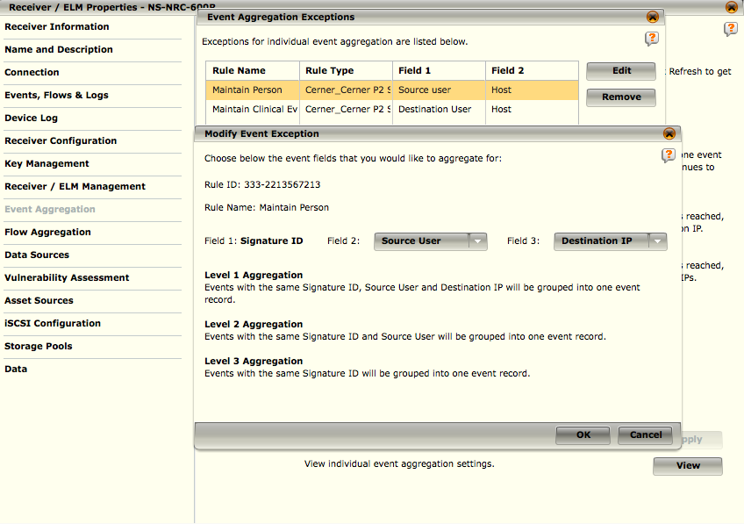
Modify Event Aggregation Settings
On an event view, highlight the event(s) for which you would like to set exceptions.
Click on the View Menu icon ( ), and select Edit. The Modify Event Exception dialog opens.
Select the field types for which you would like to aggregate from the Field 2 and Field 3 drop-down lists.
2
3
NOTE
The fields you select in Field 2 and Field 3 must be different types or an error will result
1
Notes:
The Modify aggregation settings option on the View menu allows you to create exceptions to these general aggregation settings for individual rules
The Field 2 and Field 3 options are:
• Application
• Application Protocol
Command
• Contact name
• Contact Nickname
• Database Name
• Destination IP
• Destination User
• Domain
• File Operation
• File Operation Succeeded
• Host
• Method
• NAT_Details
• Object
• Object_Type
• Response_Time
• Source IP
• Source User
• User_Nickname
Continued on next page

Slide 23
Hidden
Notes:
When you select these field types, the description for Level 1 Aggregation, Level 2 Aggregation, and Level 3 Aggregation on the Edit Exceptions dialog will change to reflect the selections you made. The time limits for each level will depend on the Event Aggregation setting you defined for the device.

Slide 24
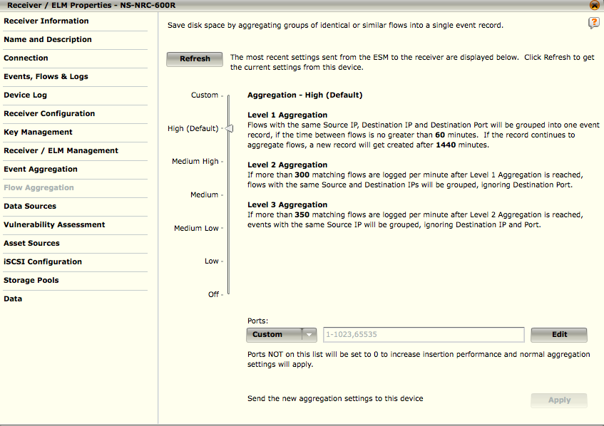
Flow Aggregation
Aggregated flows are flows for which fields source IP, destination IP, and destination port match
Flow aggregation is enabled by default
Instead of forcing you to sift through thousands of identical flows, the flow aggregation feature allows you to conveniently view them as a single flow with an “flow count” that indicates the number of times the flow occurred
Notes:
Using flow aggregation also more efficiently utilizes disk space on both the device and ESM since it eliminates the need to store each packet which generated one of the flows. This feature only applies to those rules that have aggregation enabled in the Policy Editor.
Aggregated flows use the first time, last time, and total fields to indicate the duration and amount of aggregation. For example, if the same flow occurred 30 times in the first ten minutes after noon, the flow’s first time field might contain the time 12:00 (the time of the first instance of the flow), the last time field might contain the time 12:10 (the time of the last instance of the flow), and the total field would contain the value 30.

Slide 25
Flow Aggregation – High (Default)
Level 1 Aggregation: Flows with the same Source IP, Destination IP and Destination Port will be grouped into one flow record, if the time between flows is no greater than 60 minutes. If the record continues to aggregate flows, a new record will get created after 1440 minutes.
Level 2 Aggregation: If more than 300 matching flows are logged per minute after Level 1 Aggregation is reached, flows with the same Source and Destination IPs will be grouped, ignoring Destination Port.
Level 3 Aggregation: If more than 350 matching flows are logged per minute after Level 2 Aggregation is reached, flows will be grouped into one record, ignoring Source IP, Destination IP and Destination Port.
Notes:
How flow aggregation levels move from one level to the next higher level using default “HIGH” settings.
Start at Level 1 Aggregation
Receive flow with SIP 1, DIP 2, DPT 1 and see if flow already exists.
If flow does not exist create new event record.
If flow does exist increment the flow count and update the last time field in previous flow record.
Flows continue to be received repeating step 1 until 300 flow records have been created within one (1) minute.
If 300 or less flows have been received in one (1) minute stay at level 1 aggregation
If 301 or more flows have been received transition to level 2 aggregation
Level 2 Aggregation
Receive flows with SIP 1, DIP 2, DPT 1 and see if flow already exists.
If flow does not exist set the Destination IP (DIP) to 0.0.0.0 and check if flow record for this aggregated flow exists
If aggregated flow (DIP 0.0.0.0) exists update flow record count
If aggregated flow (DIP 0.0.0.0) does not exist create a new aggregated flow record with DIP 0.0.0.0
If flow does exist increment the flow count and update the last time field in previous aggregated flow record.
Flows continue to be received repeating step 1 until 350 flow records have created within one (1) minute
If 350 or less flows have been received in one (1) minute stay at level 2 aggregation
If 351 or more flows have been received transition to level 3 aggregation
Continued on next page

Slide 26
Hidden
Notes:
Level 3 Aggregation
Receive flows with SIP 1, DIP 2, DPT 1 and see if flow already exists.
If flow does not exist set the Source IP (SIP) to 0.0.0.0 and check if flow record for this aggregated flow exists
If aggregated flow (SIP 0.0.0.0) exists update flow record count
If aggregated flow (SIP 0.0.0.0) does not exist create a new aggregated flow record with SIP 0.0.0.0
If flow does exist increment the flow count and update the last time field in previous aggregated flow record.
Flows continue to be received repeating step 1 until a 60 minute or 1 Hour time window expires.

Slide 27
Flow Aggregation – Medium High
Level 1 Aggregation: Flows with the same Source IP, Destination IP and Destination Port will be grouped into one flow record, if the time between flows is no greater than 45 minutes. If the record continues to aggregate flows, a new record will get created after 820 minutes.
Level 2 Aggregation: If more than 1000 matching flows are logged per minute after Level 1 Aggregation is reached, flows with the same Source and Destination IPs will be grouped, ignoring Destination Port.
Level 3 Aggregation: If more than 1500 matching flows are logged per minute after Level 2 Aggregation is reached, flows will be grouped into one record, ignoring Source IP, Destination IP and Destination Port.
Notes:
How flow aggregation levels move from one level to the next higher level using default “Medium High” settings.
Start at Level 1 Aggregation
Receive flow with SIP 1, DIP 2, DPT 1 and see if flow already exists.
If flow does not exist create new event record.
If flow does exist increment the flow count and update the last time field in previous flow record.
Flows continue to be received repeating step 1 until 300 flow records have been created within one (1) minute.
If 1000 or less flows have been received in one (1) minute stay at level 1 aggregation
If 1001 or more flows have been received transition to level 2 aggregation
Level 2 Aggregation
Receive flows with SIP 1, DIP 2, DPT 1 and see if flow already exists.
If flow does not exist set the Destination IP (DIP) to 0.0.0.0 and check if flow record for this aggregated flow exists
If aggregated flow (DIP 0.0.0.0) exists update flow record count
If aggregated flow (DIP 0.0.0.0) does not exist create a new aggregated flow record with DIP 0.0.0.0
If flow does exist increment the flow count and update the last time field in previous aggregated flow record.
Flows continue to be received repeating step 1 until 350 flow records have created within one (1) minute
If 1500 or less flows have been received in one (1) minute stay at level 2 aggregation
If 1501 or more flows have been received transition to level 3 aggregation
Continued on next page

Slide 28
Hidden
Notes:
Level 3 Aggregation
Receive flows with SIP 1, DIP 2, DPT 1 and see if flow already exists.
If flow does not exist set the Source IP (SIP) to 0.0.0.0 and check if flow record for this aggregated flow exists
If aggregated flow (SIP 0.0.0.0) exists update flow record count
If aggregated flow (SIP 0.0.0.0) does not exist create a new aggregated flow record with SIP 0.0.0.0
If flow does exist increment the flow count and update the last time field in previous aggregated flow record.
Flows continue to be received repeating step 1 until a 60 minute or 1 Hour time window expires.

Slide 29
Flow Aggregation - Medium
Level 1 Aggregation: Flows with the same Source IP, Destination IP and Destination Port will be grouped into one flow record, if the time between flows is no greater than 32 minutes. If the record continues to aggregate flows, a new record will get created after 620 minutes.
Level 2 Aggregation: If more than 10000 matching flows are logged per minute after Level 1 Aggregation is reached, flows with the same Source and Destination IPs will be grouped, ignoring Destination Port.
Level 3 Aggregation: If more than 15000 matching flows are logged per minute after Level 2 Aggregation is reached, flows will be grouped into one record, ignoring Source IP, Destination IP and Destination Port.
Notes:
How flow aggregation levels move from one level to the next higher level using default “Medium” settings.
Start at Level 1 Aggregation
Receive flow with SIP 1, DIP 2, DPT 1 and see if flow already exists.
If flow does not exist create new event record.
If flow does exist increment the flow count and update the last time field in previous flow record.
Flows continue to be received repeating step 1 until 300 flow records have been created within one (1) minute.
If 10000 or less flows have been received in one (1) minute stay at level 1 aggregation
If 10001 or more flows have been received transition to level 2 aggregation
Level 2 Aggregation
Receive flows with SIP 1, DIP 2, DPT 1 and see if flow already exists.
If flow does not exist set the Destination IP (DIP) to 0.0.0.0 and check if flow record for this aggregated flow exists
If aggregated flow (DIP 0.0.0.0) exists update flow record count
If aggregated flow (DIP 0.0.0.0) does not exist create a new aggregated flow record with DIP 0.0.0.0
If flow does exist increment the flow count and update the last time field in previous aggregated flow record.
Flows continue to be received repeating step 1 until 350 flow records have created within one (1) minute
If 15000 or less flows have been received in one (1) minute stay at level 2 aggregation
If 15001 or more flows have been received transition to level 3 aggregation
Continued on next page

Slide 30
Hidden
Notes:
Level 3 Aggregation
Receive flows with SIP 1, DIP 2, DPT 1 and see if flow already exists.
If flow does not exist set the Source IP (SIP) to 0.0.0.0 and check if flow record for this aggregated flow exists
If aggregated flow (SIP 0.0.0.0) exists update flow record count
If aggregated flow (SIP 0.0.0.0) does not exist create a new aggregated flow record with SIP 0.0.0.0
If flow does exist increment the flow count and update the last time field in previous aggregated flow record.
Flows continue to be received repeating step 1 until a 60 minute or 1 Hour time window expires.

Slide 31
Flow Aggregation – Medium Low
Level 1 Aggregation: Flows with the same Source IP, Destination IP and Destination Port will be grouped into one flow record, if the time between flows is no greater than 15 minutes. If the record continues to aggregate flows, a new record will get created after 300 minutes.
Level 2 Aggregation: If more than 10000 matching flows are logged per minute after Level 1 Aggregation is reached, flows with the same Source and Destination IPs will be grouped, ignoring Destination Port.
Level 3 Aggregation: If more than 150000 matching flows are logged per minute after Level 2 Aggregation is reached, flows will be grouped into one record, ignoring Source IP, Destination IP and Destination Port.
Notes:
How flow aggregation levels move from one level to the next higher level using default “Medium Low” settings.
Start at Level 1 Aggregation
Receive flow with SIP 1, DIP 2, DPT 1 and see if flow already exists.
If flow does not exist create new event record.
If flow does exist increment the flow count and update the last time field in previous flow record.
Flows continue to be received repeating step 1 until 300 flow records have been created within one (1) minute.
If 10000 or less flows have been received in one (1) minute stay at level 1 aggregation
If 10001 or more flows have been received transition to level 2 aggregation
Level 2 Aggregation
Receive flows with SIP 1, DIP 2, DPT 1 and see if flow already exists.
If flow does not exist set the Destination IP (DIP) to 0.0.0.0 and check if flow record for this aggregated flow exists
If aggregated flow (DIP 0.0.0.0) exists update flow record count
If aggregated flow (DIP 0.0.0.0) does not exist create a new aggregated flow record with DIP 0.0.0.0
If flow does exist increment the flow count and update the last time field in previous aggregated flow record.
Flows continue to be received repeating step 1 until 350 flow records have created within one (1) minute
If 15000 or less flows have been received in one (1) minute stay at level 2 aggregation
If 15001 or more flows have been received transition to level 3 aggregation
Continued on next page

Slide 32
Hidden
Notes:
Level 3 Aggregation
Receive flows with SIP 1, DIP 2, DPT 1 and see if flow already exists.
If flow does not exist set the Source IP (SIP) to 0.0.0.0 and check if flow record for this aggregated flow exists
If aggregated flow (SIP 0.0.0.0) exists update flow record count
If aggregated flow (SIP 0.0.0.0) does not exist create a new aggregated flow record with SIP 0.0.0.0
If flow does exist increment the flow count and update the last time field in previous aggregated flow record.
Flows continue to be received repeating step 1 until a 60 minute or 1 Hour time window expires.

Slide 33
Flow Aggregation - Low
Level 1 Aggregation: Flows with the same Source IP, Destination IP and Destination Port will be grouped into one flow record, if the time between flows is no greater than 5 minutes. If the record continues to aggregate flows, a new record will get created after 60 minutes.
Level 2 Aggregation: If more than 500000 matching flows are logged per minute after Level 1 Aggregation is reached, flows with the same Source and Destination IPs will be grouped, ignoring Destination Port.
Level 3 Aggregation: If more than 500000 matching flows are logged per minute after Level 2 Aggregation is reached, flows will be grouped into one record, ignoring Source IP, Destination IP and Destination Port
Notes:
How flow aggregation levels move from one level to the next higher level using default “Low” settings.
Start at Level 1 Aggregation
Receive flow with SIP 1, DIP 2, DPT 1 and see if flow already exists.
If flow does not exist create new event record.
If flow does exist increment the flow count and update the last time field in previous flow record.
Flows continue to be received repeating step 1 until 300 flow records have been created within one (1) minute.
If 500000 or less flows have been received in one (1) minute stay at level 1 aggregation
If 500001 or more flows have been received transition to level 2 aggregation
Level 2 Aggregation
Receive flows with SIP 1, DIP 2, DPT 1 and see if flow already exists.
If flow does not exist set the Destination IP (DIP) to 0.0.0.0 and check if flow record for this aggregated flow exists
If aggregated flow (DIP 0.0.0.0) exists update flow record count
If aggregated flow (DIP 0.0.0.0) does not exist create a new aggregated flow record with DIP 0.0.0.0
If flow does exist increment the flow count and update the last time field in previous aggregated flow record.
Flows continue to be received repeating step 1 until 350 flow records have created within one (1) minute
If 500000 or less flows have been received in one (1) minute stay at level 2 aggregation
If 500001 or more flows have been received transition to level 3 aggregation
Continued on next page

Slide 34
Hidden
Notes:
Level 3 Aggregation
Receive flows with SIP 1, DIP 2, DPT 1 and see if flow already exists.
If flow does not exist set the Source IP (SIP) to 0.0.0.0 and check if flow record for this aggregated flow exists
If aggregated flow (SIP 0.0.0.0) exists update flow record count
If aggregated flow (SIP 0.0.0.0) does not exist create a new aggregated flow record with SIP 0.0.0.0
If flow does exist increment the flow count and update the last time field in previous aggregated flow record.
Flows continue to be received repeating step 1 until a 60 minute or 1 Hour time window expires.

Slide 35
Flow Aggregation - Custom
Level 1 Aggregation: Flows with the same Source IP, Destination IP and Destination Port will be grouped into one flow record, if the time between flows is no greater than (select setting) minutes. If the record continues to aggregate flows, a new record will get created after (select setting) minutes.
Level 2 Aggregation: If more than (select setting) matching flows are logged per minute after Level 1 Aggregation is reached, flows with the same Source and Destination IPs will be grouped, ignoring Destination Port.
Level 3 Aggregation: If more than (select setting) matching flows are logge3d per minute after Level 2 Aggregation is reached, flows will be grouped into one record, ignoring Source IP, Destination IP and Destination Port.
Notes:
As each network is different, the default aggregation settings may not be optimal for the flows generated by your network traffic and may need to be raised or lowered until they fit your needs. This Custom setting allows you to define specific attributes for each aggregation level. The attributes that you are able to define are indicated by a text box with up and down arrows, which enable you to select the desired number. When you select the Custom level, the following explanation for each of the levels is displayed:

Slide 36
Flow Aggregation - Ports
This option allows you to configure the flow port aggregation values that need to be maintained.
On the Ports drop-down list, select None, All, or Custom. If you select Custom, the Port Value field and Edit button will become active.
To modify the value(s) in the Port Value field, click on the Edit button. The Port Values screen will open.

Slide 37
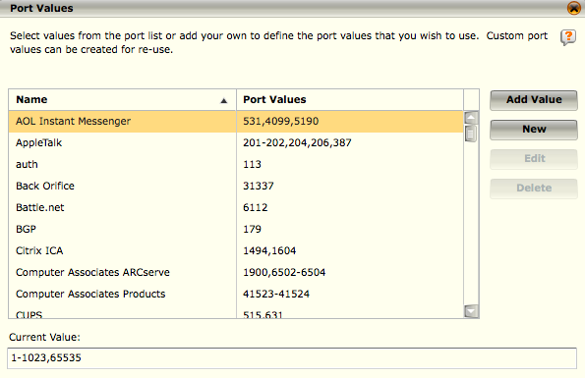
Flow Aggregation – Port Values
This option allows you to configure the flow port aggregation values that need to be maintained
You can add and edit custom port values and port ranges
Ports NOT on the defined list will be set to 0 to increase insertion performance
NOTE
The Edit and Delete buttons are only active when a user defined port value is highlighted.
Notes:
You can perform the following functions on this screen:
Add a new value to the existing table.
a. Click on the New button. The New Port screen will open.
b. Enter a name for the new port in the Name field and a value(s) (which can be single values, a list of values separated by commas, or ranges) in the Value field.
c. Click OK. The new port value will be added to the list of existing values.
d. You can then highlight it and click on OK to add it to the Port Value field on the Flow Aggregation screen.
Select an existing value.
a. Double click on the desired item on the list or highlight it and click on Add Value.
b. Click on OK. It will be added to the Port Value field on the Flow Aggregation screen.
Combine existing values.
a. Highlight a value and click on the Add Value button. The value will be added to the Current Value text box at the bottom of the screen.
b. Click on the next value and click on the Add Value button. The second value will be added to the first in the Current Value text box, separated by a comma.
c. Once you have combined all the desired values, click on OK. That custom value combination will be added to the Port Value field on the Flow Aggregation screen.
Modify or remove a custom port value from the Port Values list.
a. Highlight the value to be modified or removed.
b. Click on the Edit button to modify the value or the Delete button to remove it.

Slide 38
Using event aggregation more efficiently utilizes disk space on both the device and ESM and it eliminates the need to store each packet that generated one of the events.
True
False
Notes:
Answer: True

Slide 39
What is the McAfee default event aggregation setting?
Medium-Low
Medium
High
Low
High-Medium
None
Notes:
Answer: High

Slide 40
Default event aggregation occurs on what fields?
Username
Signature ID
Source Port
Source IP
Destination IP
Destination Port
Notes:
Answer: Source IP, Destination IP, and Signature ID

Slide 41
Default flow aggregation occurs on what fields?
Username
Signature ID
Source Port
Source IP
Destination IP
Destination Port
Notes:
Answer: Source IP, Destination IP, and Destination Port

Slide 42
Hands-on Practice Refer to the Practice Manual Practice 5: Aggregation

